Slide 1
Steganography-Enhanced Prediction-Error Expansion: A Novel Reversible Data Hiding Framework
Source: IEEE Transactions on Circuits and Systems for Video Technology, 11 November 2024
Authors: Xiang Li, Xiaolong Li, Shaohai Hu, and Yao Zhao
Speaker: Kai Gao
Date: 2024/11/28

Slide 2
Outline
Related Work
Proposed scheme
Experiment results
Conclusion

Slide 3
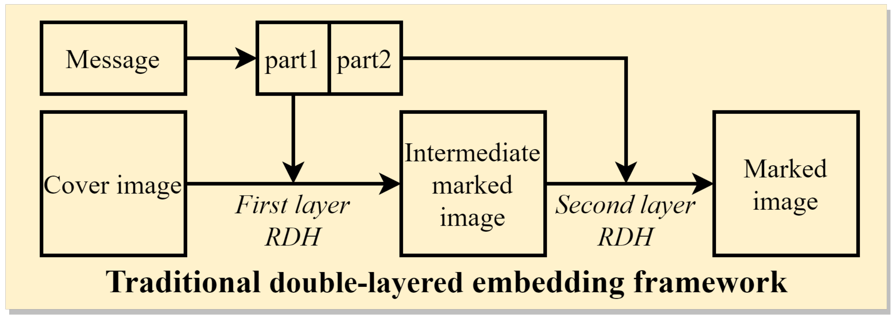
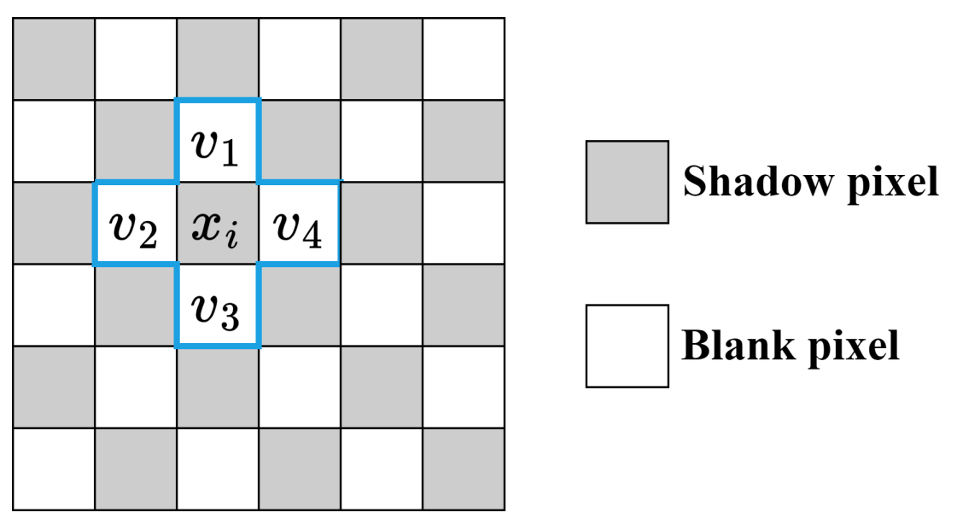
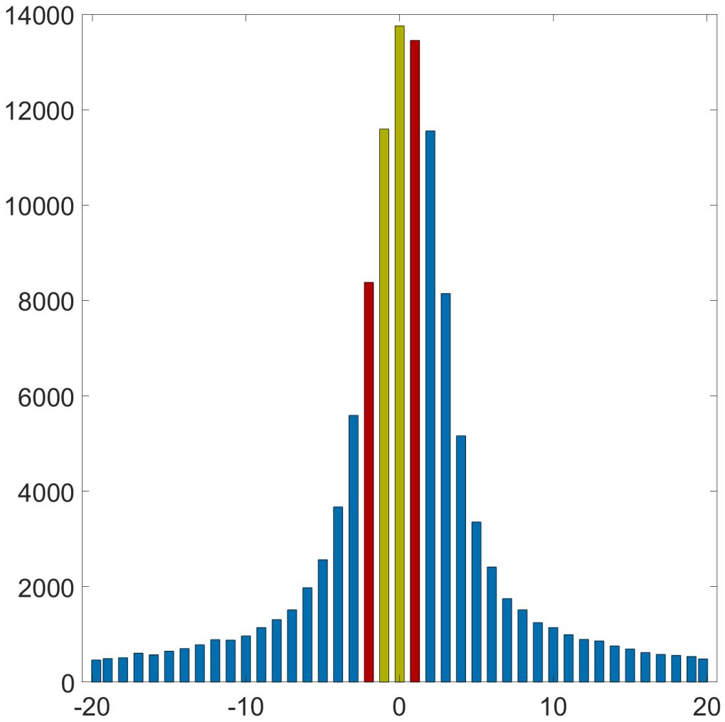
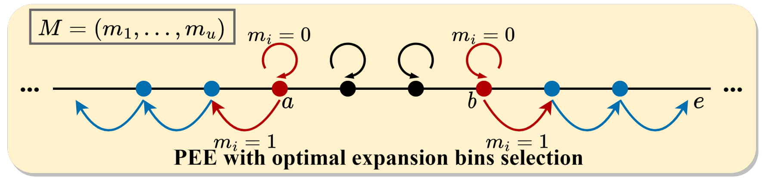
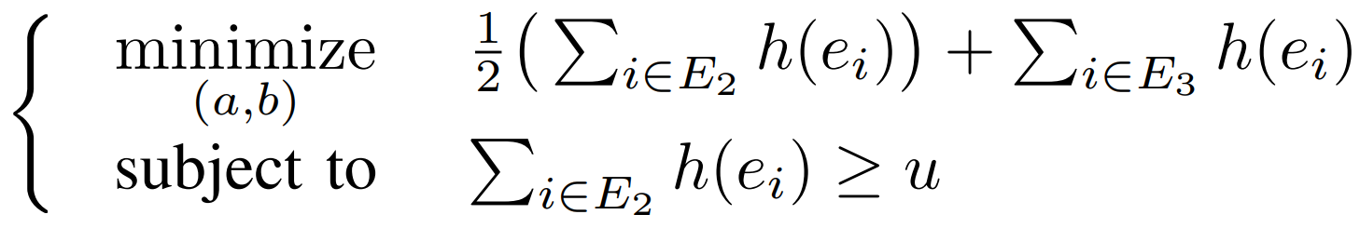
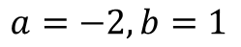
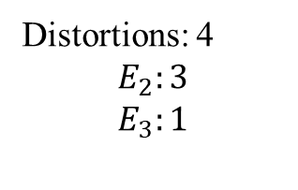
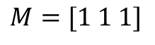
Related Work – Traditional double-layered RDH
 |  | 14 |  | 13
 | 13 | 10 | 13 | 14 | 13
 |  | 12 |  | 13
 | -2 |  | 1
 |  | -3 |  | 1
 | 1 |  | 1
 |  | 0 |  | 0
 | -3 |  | 2
 |  | -4 |  | 2
 | 1 |  | 1
 |  | 0 |  | 0
$$a=−2, b=1$$
Distortions: 4
$$E_{2}:3$$
$$E_{3}:1$$
Cover pixels
Prediction errors
Modified prediction errors
$$M=[1 1 1]$$

Slide 4
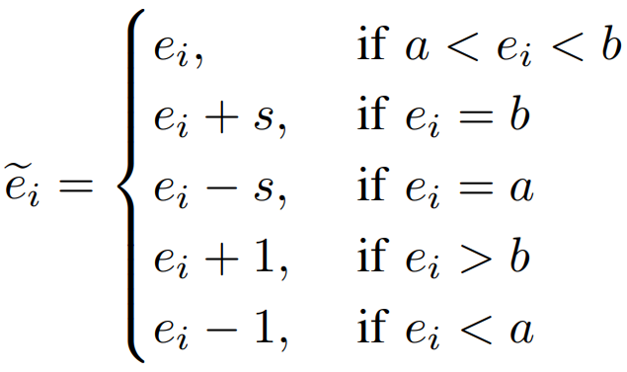
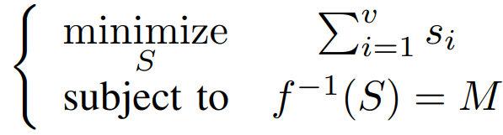
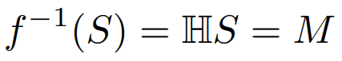
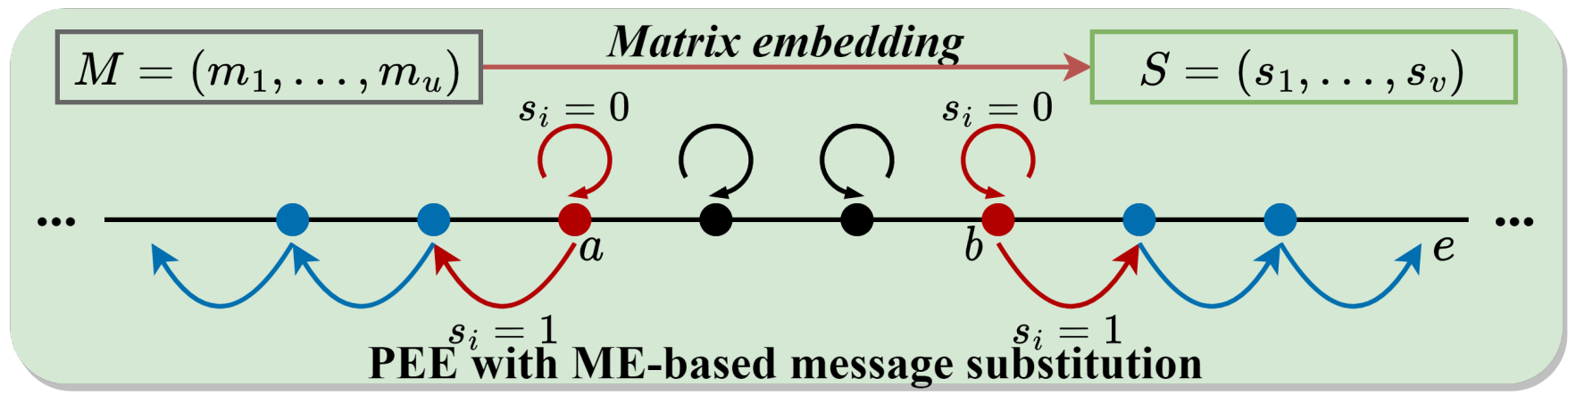
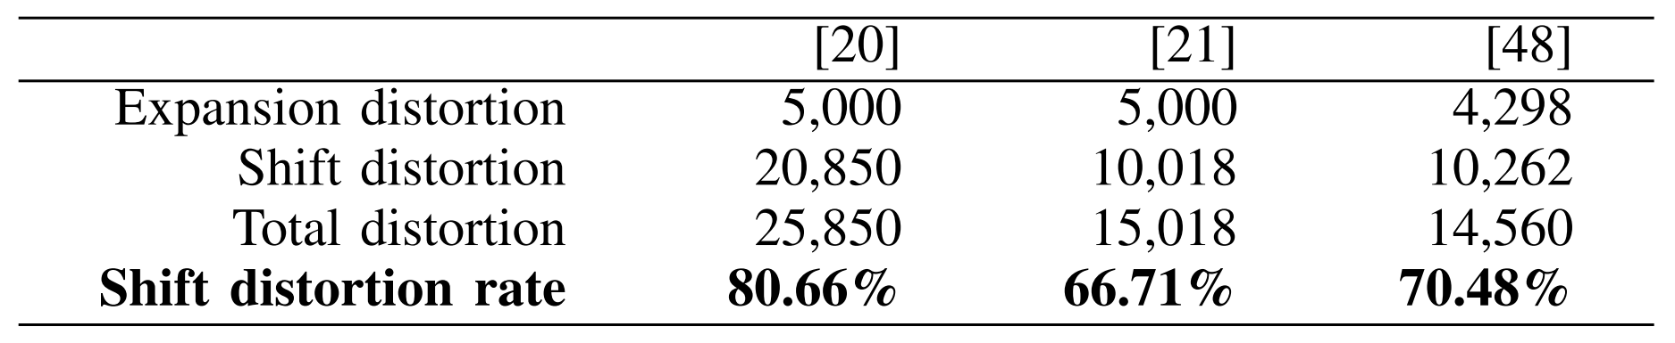
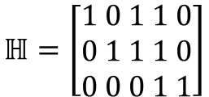
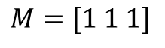
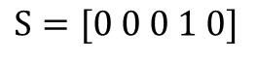
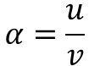

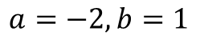
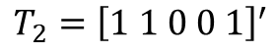
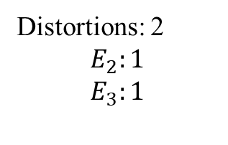
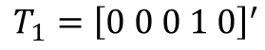
Related Work – Matrix embedding based message substitution
$$ℍ=\left[\begin{aligned}1 0 1 1 0 \\ 0 1 1 1 0 \\ 0 0 0 1 1\end{aligned}\right]$$
$$T_{1}={\left[0 0 0 1 0\right]}^{′}$$
$$α=\frac{u}{v}$$
$$M=[1 1 1]$$
$$T_{2}={\left[1 1 0 0 1\right]}^{′}$$
$$…$$
 | -2 |  | 1
 |  | -3 |  | 1
 | 1 |  | 1
 |  | 0 |  | 0
 | -2 |  | 1
 |  | -4 |  | 1
 | 2 |  | 1
 |  | 0 |  | 0
$$a=−2, b=1$$
Distortions: 2
$$E_{2}:1$$
$$E_{3}:1$$
Prediction errors
Modified prediction errors
$$S=[0 0 0 1 0]$$
[20] V. Sachnev, H. J. Kim, J. Nam, S. Suresh, and Y. Q. Shi, “Reversible Watermarking Algorithm Using Sorting and Prediction,” IEEE Trans. Circuits Syst. Video Technol., vol. 19, no. 7, pp. 989–999, 2009.
[21] H.-T. Wu and J. Huang, “Reversible Image Watermarking on Prediction Errors by Efficient Histogram Modification,” Signal Processing, vol. 92, no. 12, pp. 3000–3009, 2012.
[48] X. Liang and S. Xiang, “Reversible Data Hiding of Grayscale Images Using General Distortion Metric,” IEEE Signal Process. Lett., vol. 30, pp. 1527–1531, 2023.

Slide 5
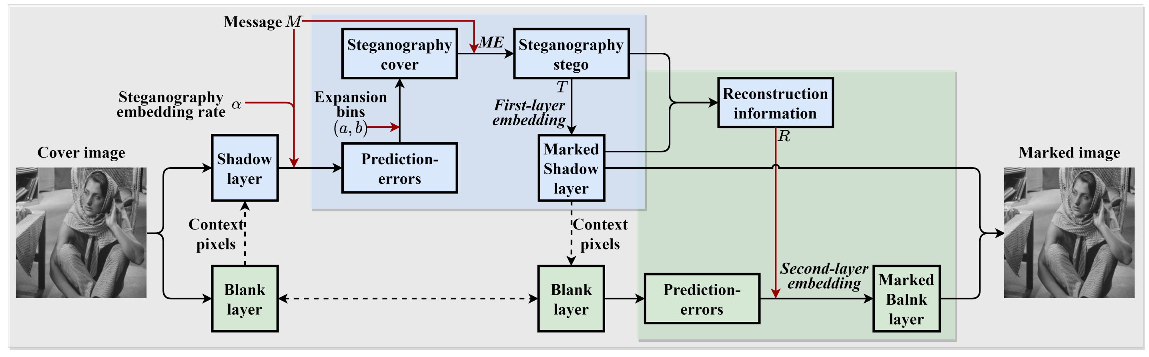
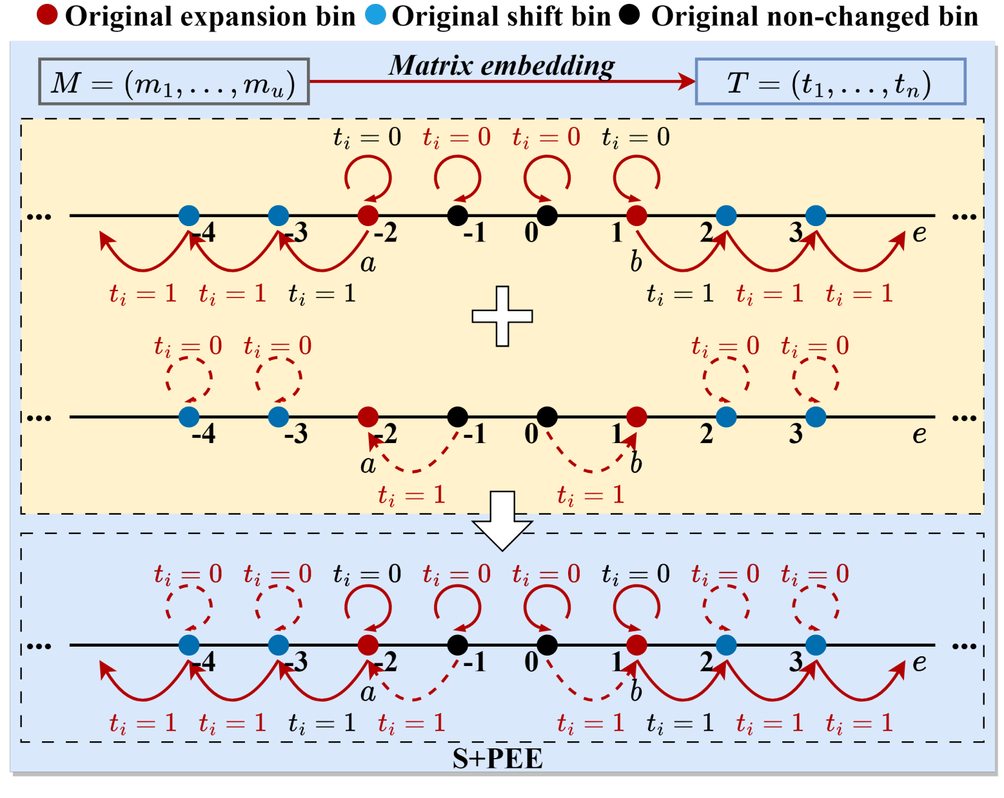
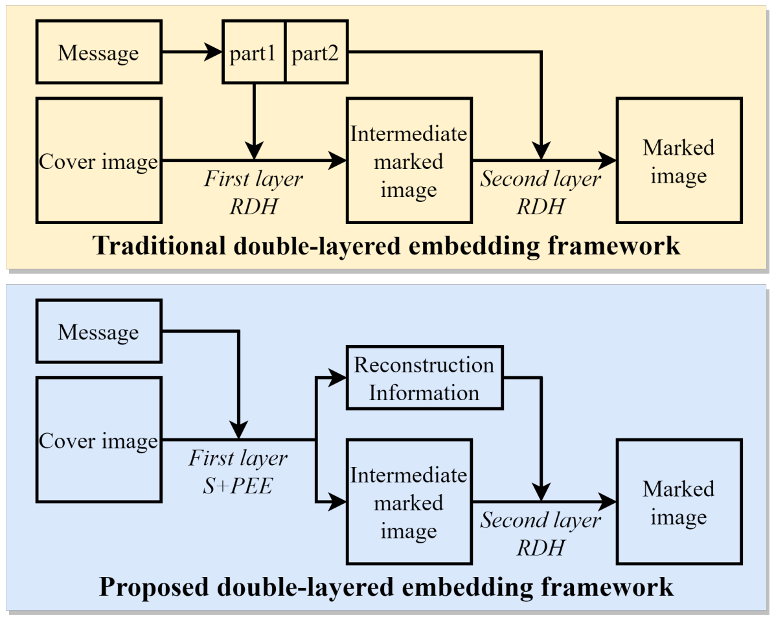
Proposed Scheme (1/3)
5

Slide 6
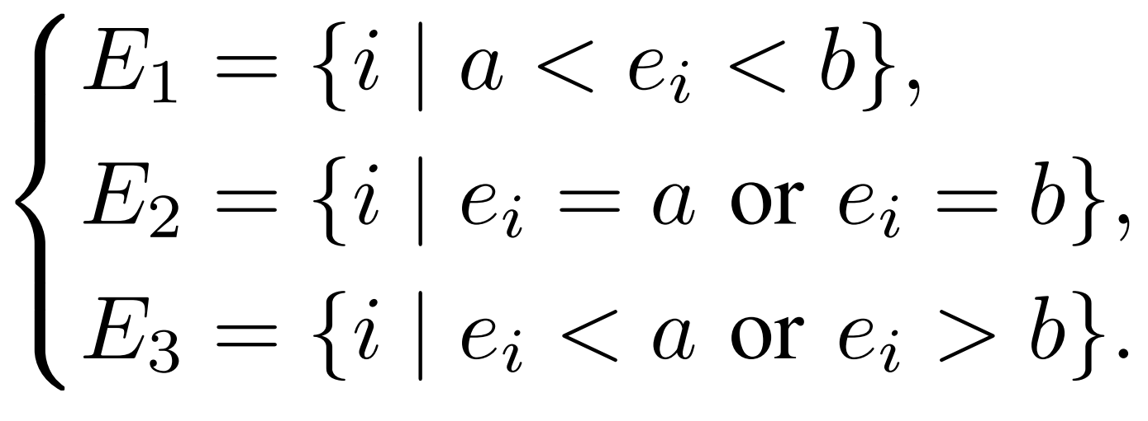
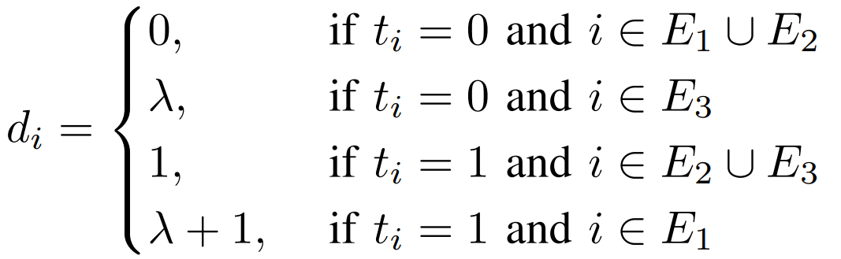
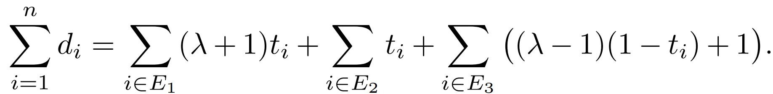
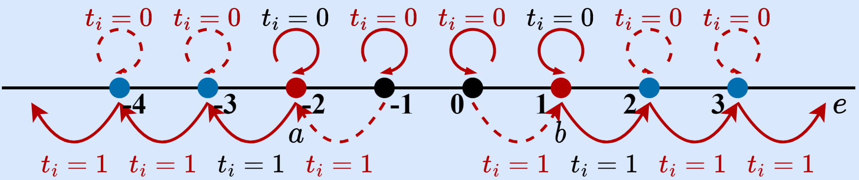
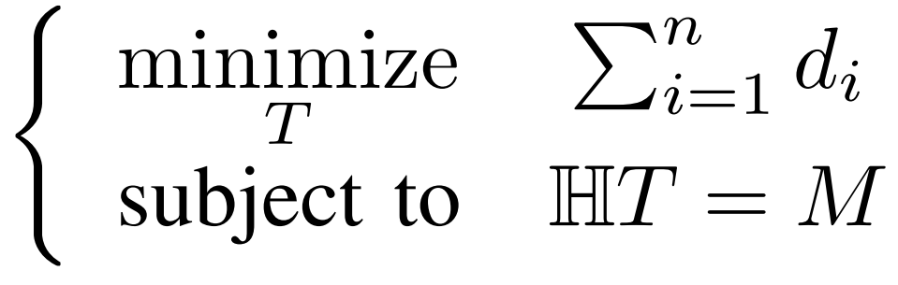
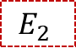
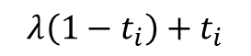
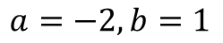
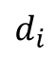
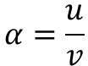
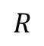
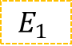
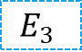
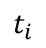
Proposed Scheme (2/3)
$$E_{1}$$
$$E_{2}$$
$$E_{3}$$
$$a=−2, b=1$$
-2 | 1 | -3 | 1 | 1 | 0 | -1 | -4
$$t_{i}$$
0 | 1 | 1 | 0 | 0 | 0 | 1 | 0
-2 | 2 | -4 | 1 | 1 | 0 | -2 | -4
$$R$$
0 | 0 | 0 | 0 | 0 |  | 1 | 1
$$d_{i}$$
0 | 1 | 1 | 0 | 0 | 0 | 101 | 100
$$α=\frac{u}{v}$$
$$α+=0.01, λ=100,a+b=−1$$
$$λ\left(1−t_{i}\right)+t_{i}$$
6

Slide 7
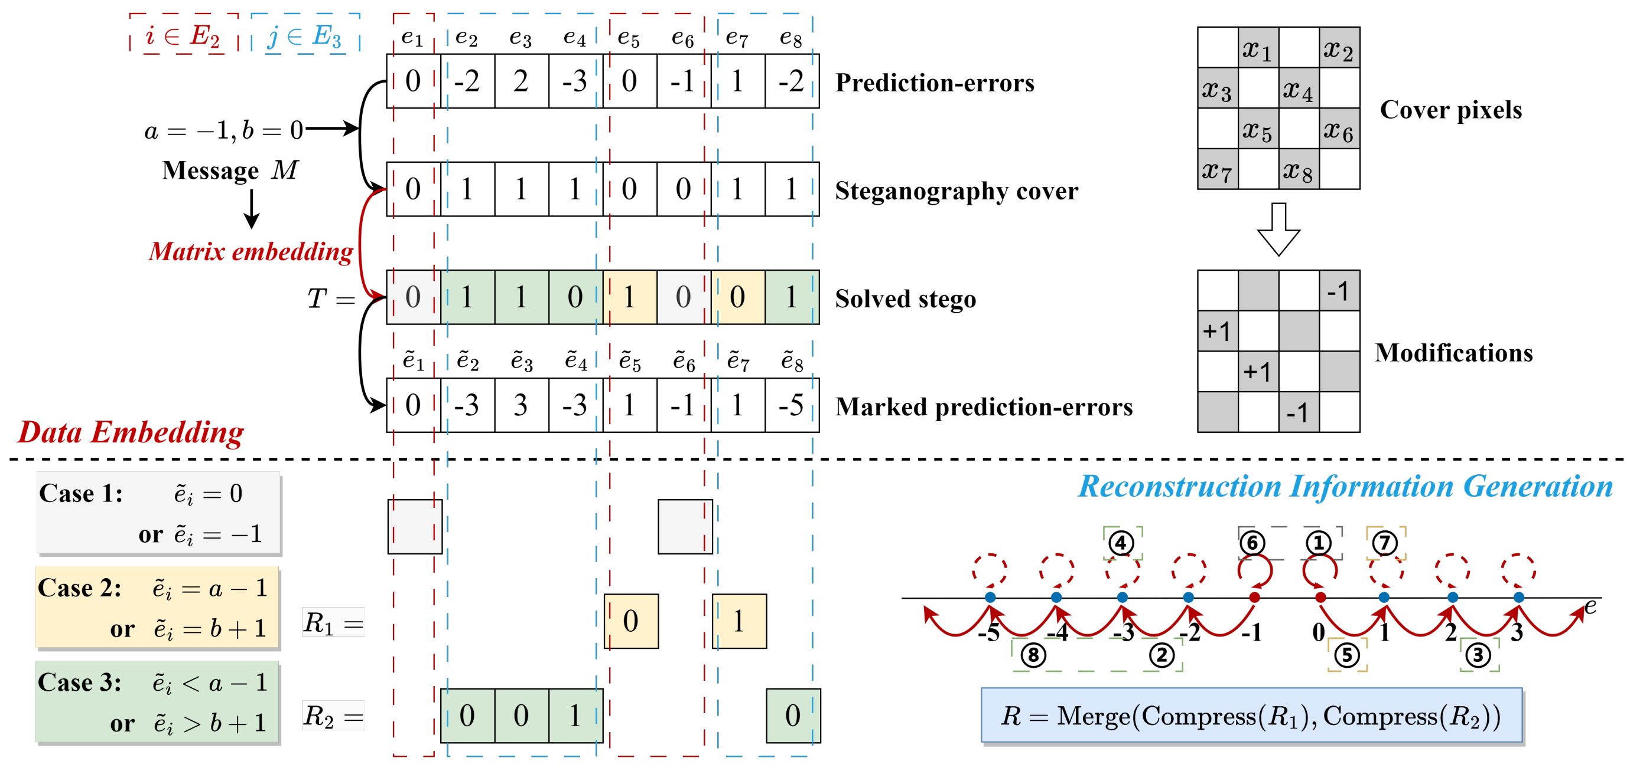
Proposed Scheme (3/3)
7

Slide 8
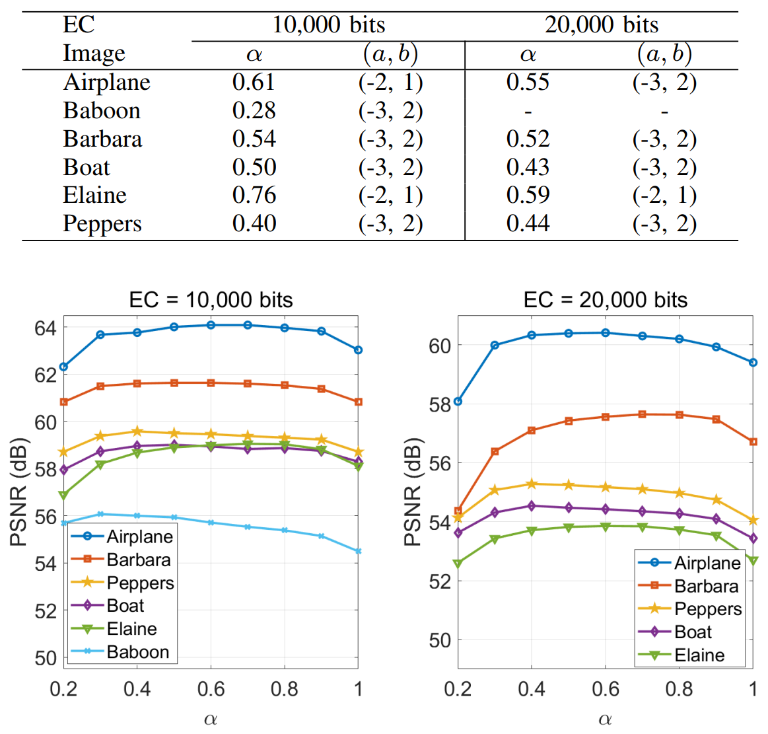
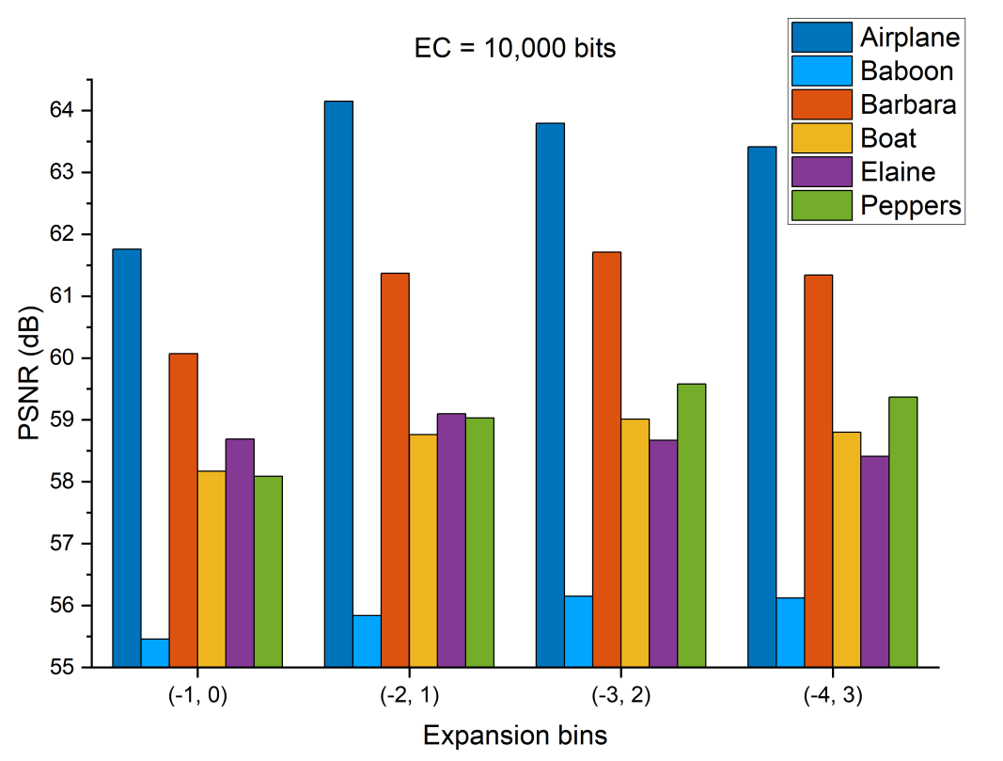
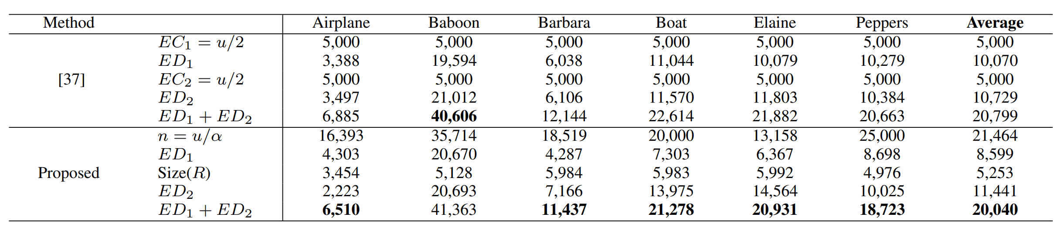
Experiment Results (1/3)
[37] X. Li, W. Zhang, X. Gui, and B. Yang, “Efficient Reversible Data Hiding Based on Multiple Histograms Modification,” IEEE Trans. Inf. Forensics Secur., vol. 10, no. 9, pp. 2016–2027, 2015.

Slide 9
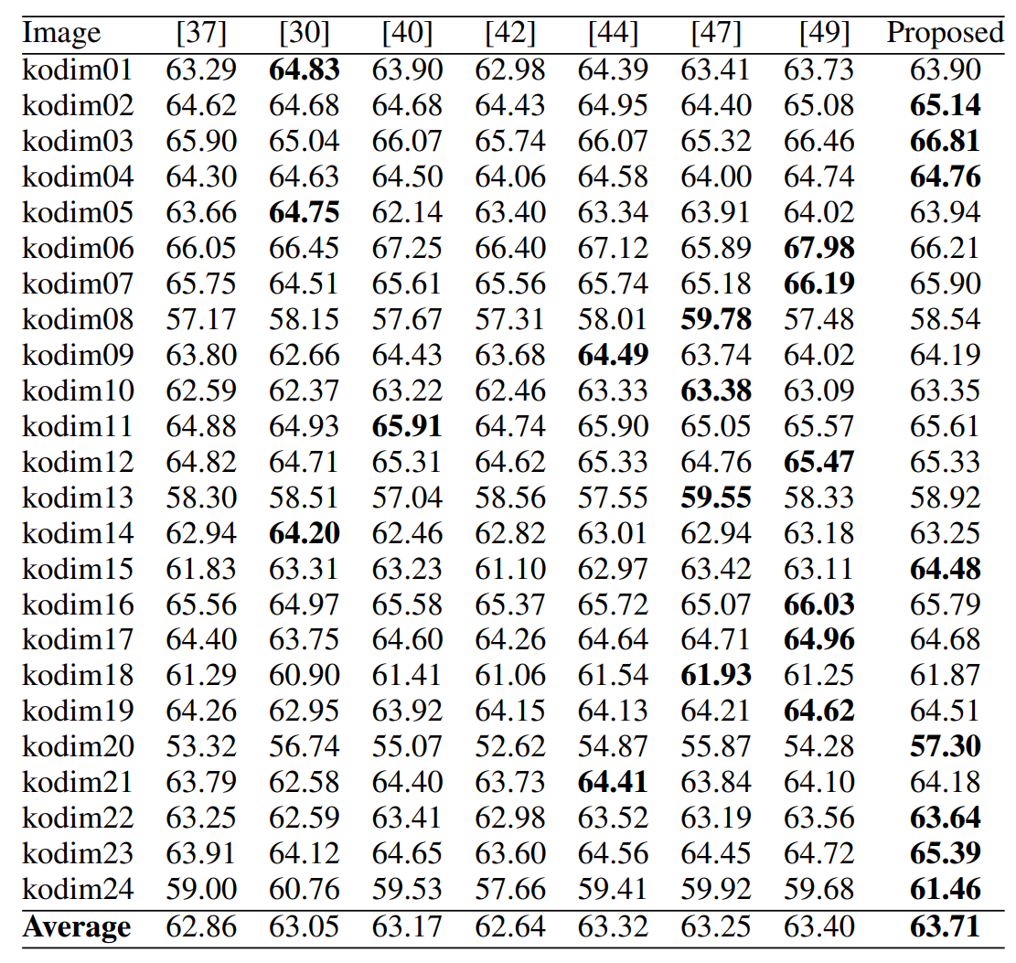
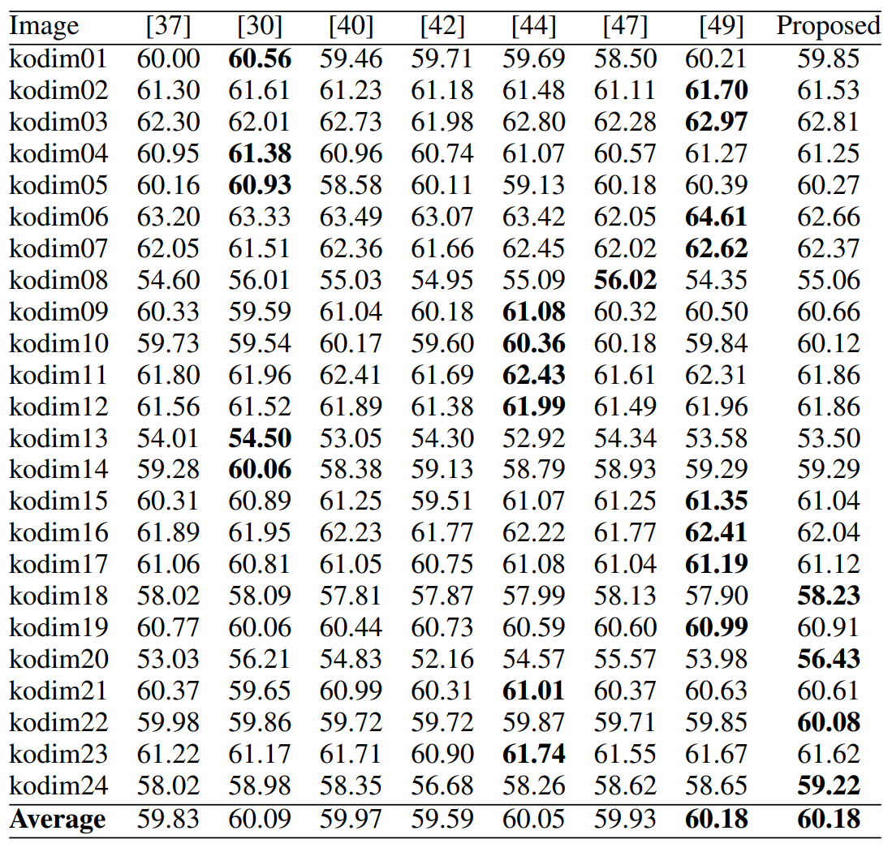
Experiment Results (2/3)
[37] X. Li, W. Zhang, X. Gui, and B. Yang, “Efficient Reversible Data Hiding Based on Multiple Histograms Modification,” IEEE Trans. Inf. Forensics Secur., vol. 10, no. 9, pp. 2016–2027, 2015.
[30] S. Kim, X. Qu, V. Sachnev, and H. J. Kim, “Skewed Histogram Shifting for Reversible Data Hiding Using a Pair of Extreme Predictions,” IEEE Trans. Circuits Syst. Video Technol., vol. 29, no. 11, pp. 3236–3246, 2019.
[40] T. Zhang, X. Li, W. Qi, and Z. Guo, “Location-Based PVO and Adaptive Pairwise Modification for Efficient Reversible Data Hiding,” IEEE Trans. Inf. Forensics and Secur., vol. 15, pp. 2306–2319, 2020.
[42] C. Zhang and B. Ou, “Reversible Data Hiding Based on Multiple Adaptive Two-Dimensional Prediction-Error Histograms Modification,” IEEE Trans. Circuits Syst. Video Technol., vol. 32, no. 7, pp. 4174–4187, 2022.
[44] S. Xiang and G. Ruan, “Efficient PVO-Based Reversible Data Hiding by Selecting Blocks with Full-Enclosing Context,” IEEE Trans. Circuits Syst. Video Technol., vol. 32, no. 5, pp. 2868–2880, 2022.
[47] G. Fan, P. Wang, Z. Li, Q. Zhou, and Z. Pan, “Global Pixel-ValueOrdering Framework with Dynamic Sequence Partition for Reversible Data Hiding,” Knowledge-Based Syst., vol. 297, p. 111930, 2024.
[49] X. Li, M. Xiao, X. Li, S. Xiang, and Y. Zhao, “Matrix Embedding Based Multiple Histograms Modification for Efficient Reversible Data Hiding,” IEEE Signal Process. Lett., vol. 31, pp. 2555–2559, 2024.

Slide 10
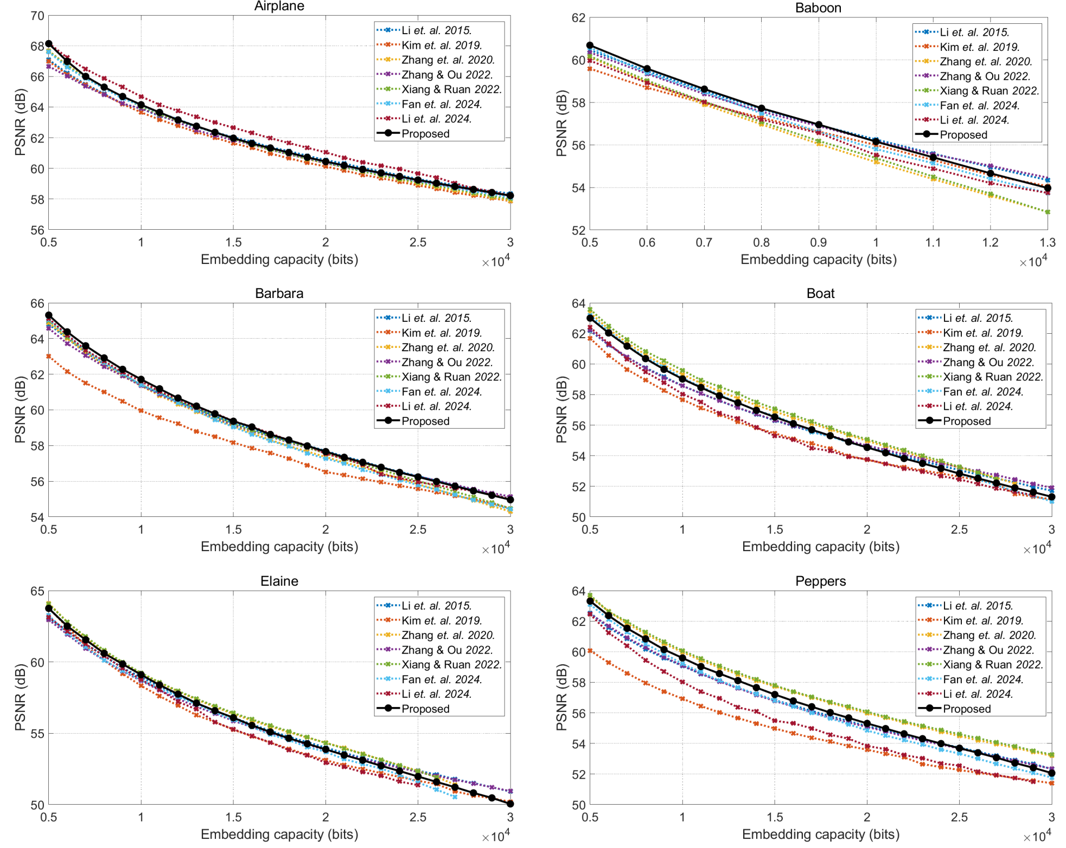
Experiment Results (3/3)

Slide 11
Conclusions
Novel double-layered RDH framework
Rate-distortion model

